Slide 1

Project 1 Global Climate Change
DSC 680
Cindy Brinkmeyer
Professor Brett Werner

Slide 2
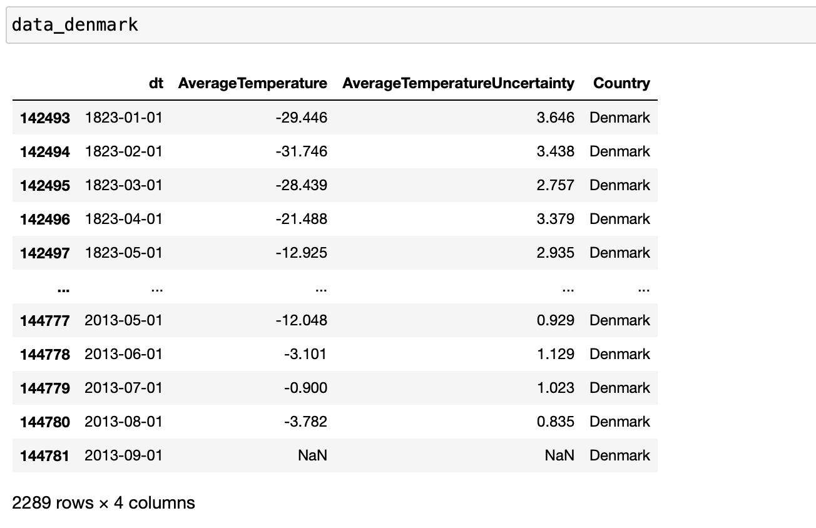
Data View for Denmark Data Set

Slide 3
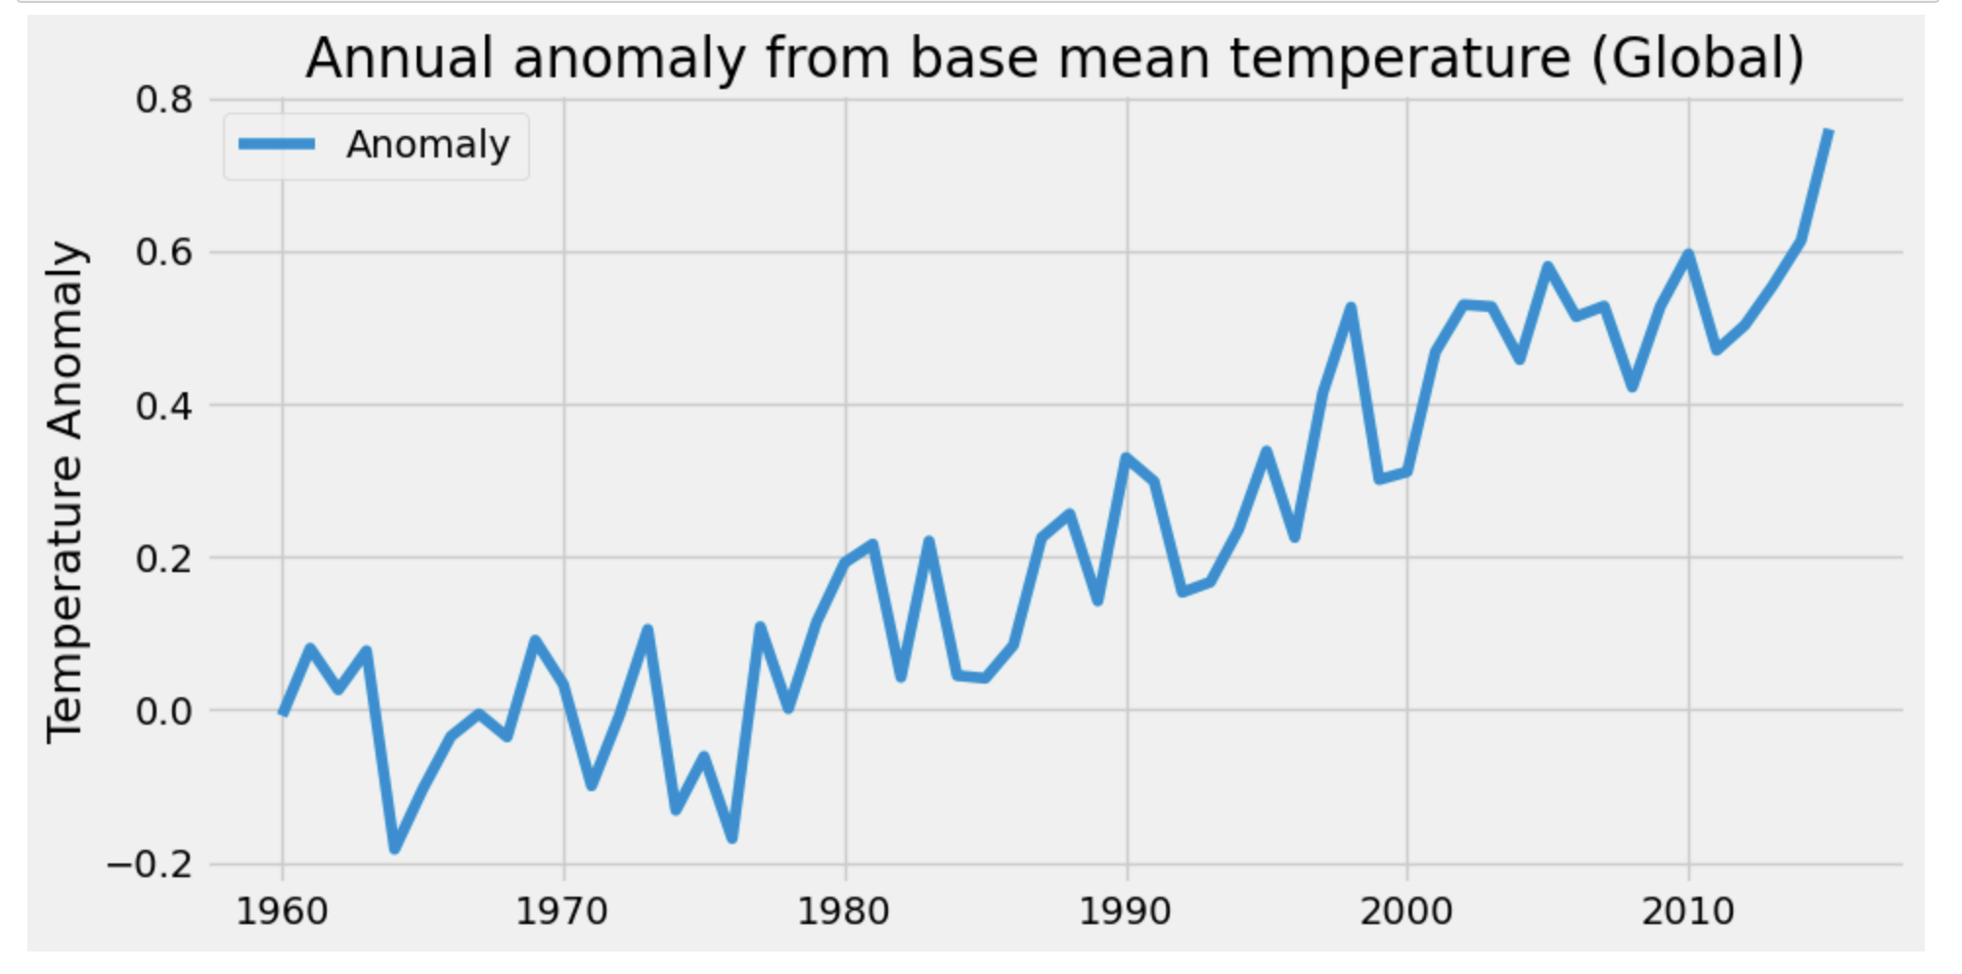
Time Series for Annual Anomaly (Global)

Slide 4
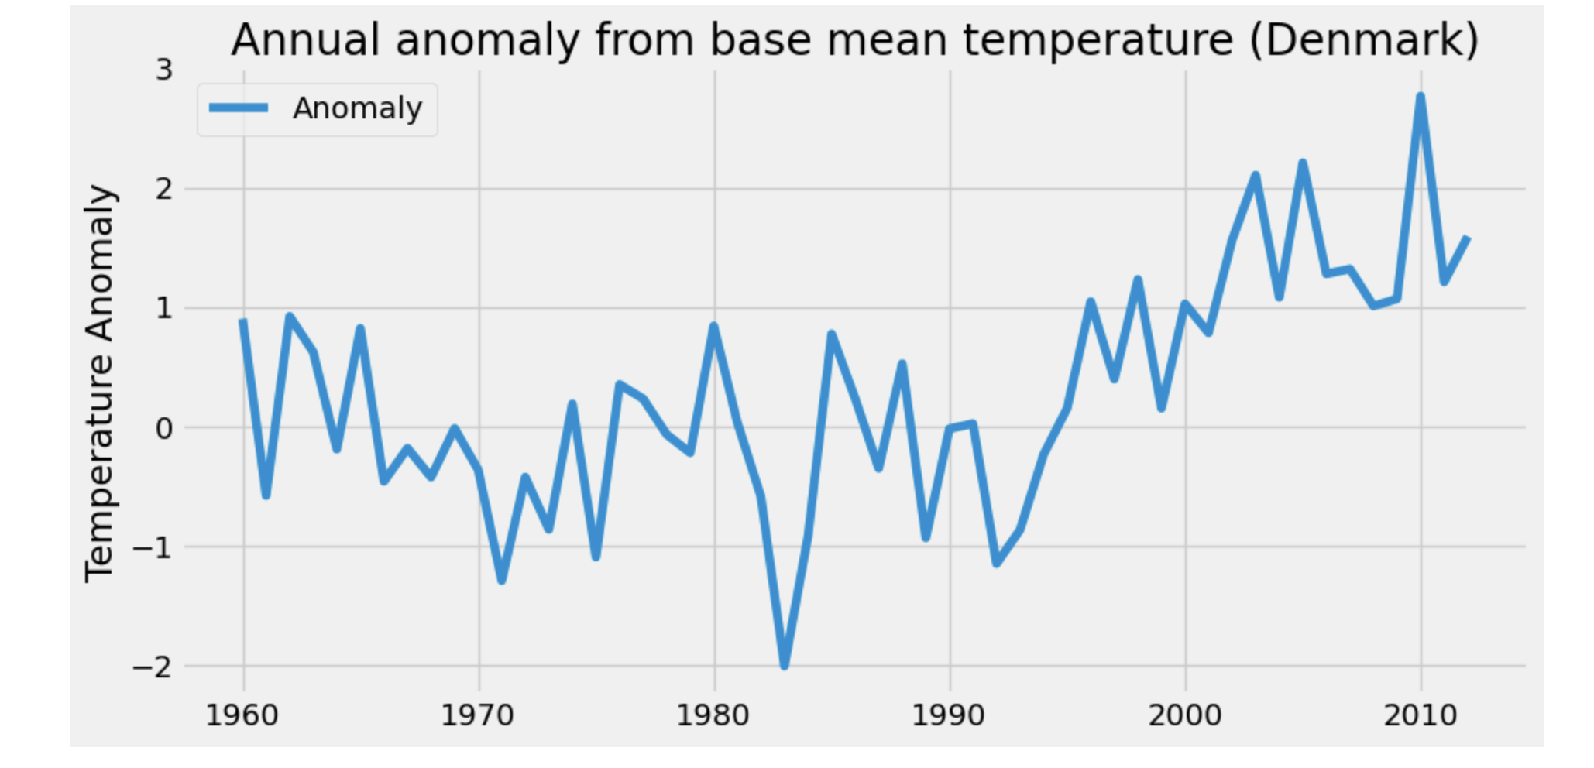
Time Series for Annual Anomaly from Mean Base Temperature (Denmark)

Slide 5
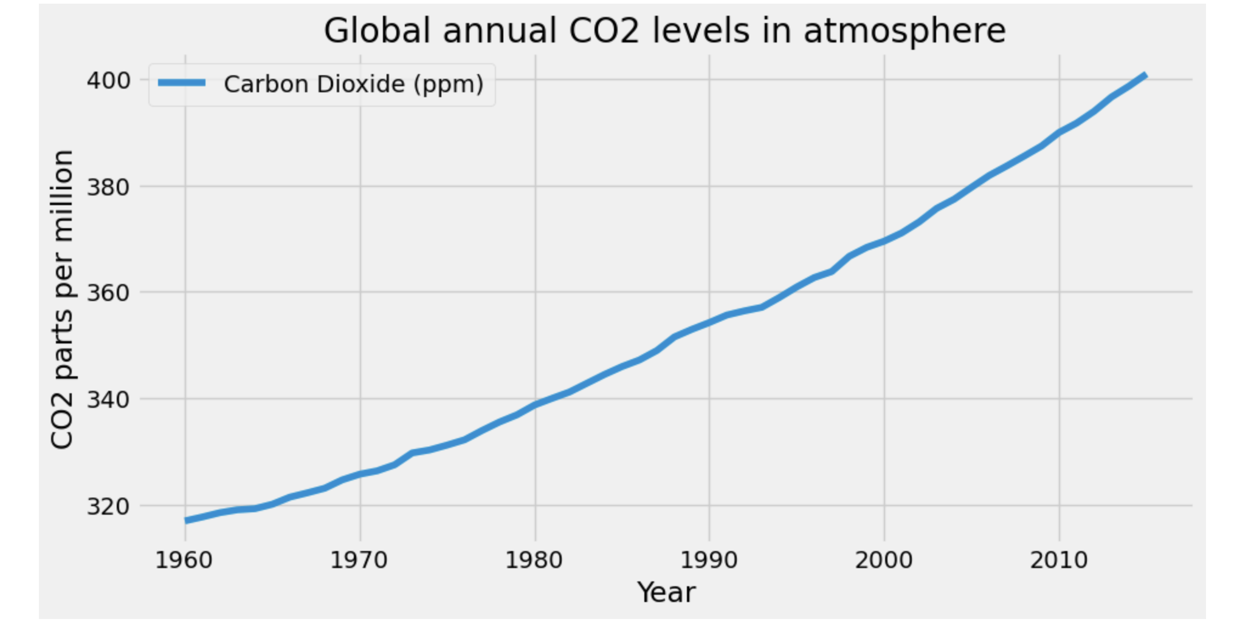
Global Annual CO2 Levels in Atmosphere

Slide 6
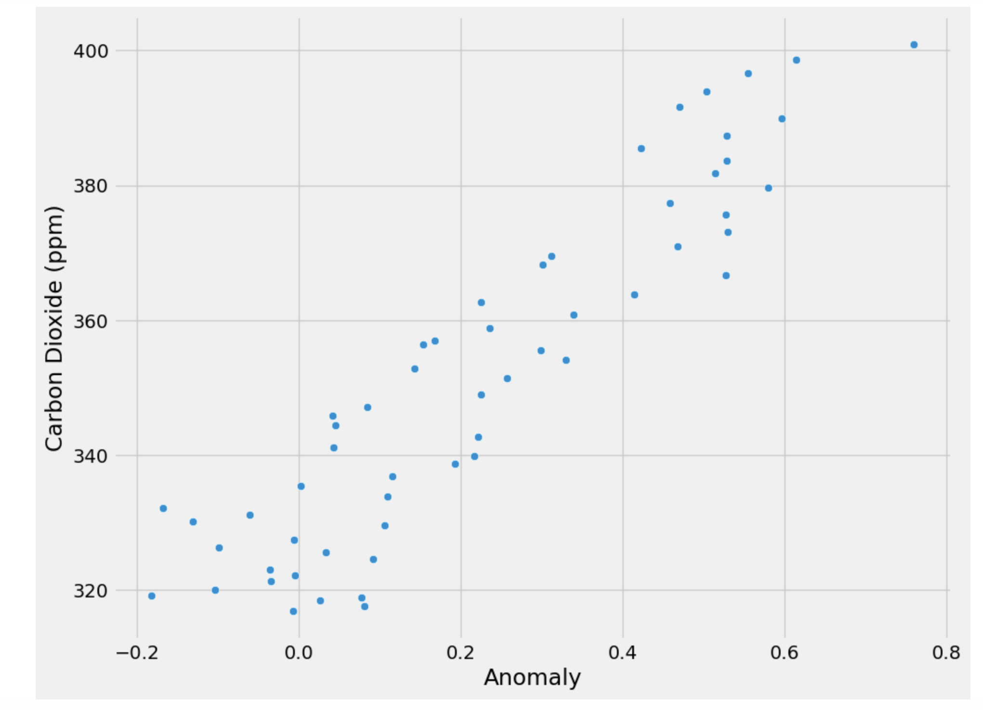
Scatter Chart with Carbon Dioxide (ppm) for the Anomaly

Slide 7
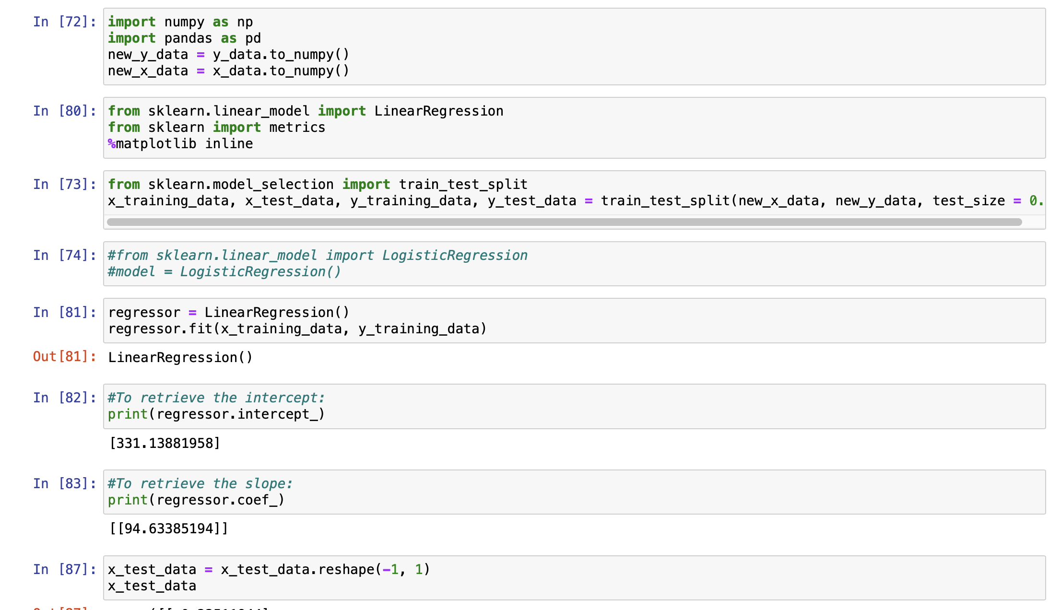
Linear Regression Code and Intercept and Slope

Slide 8
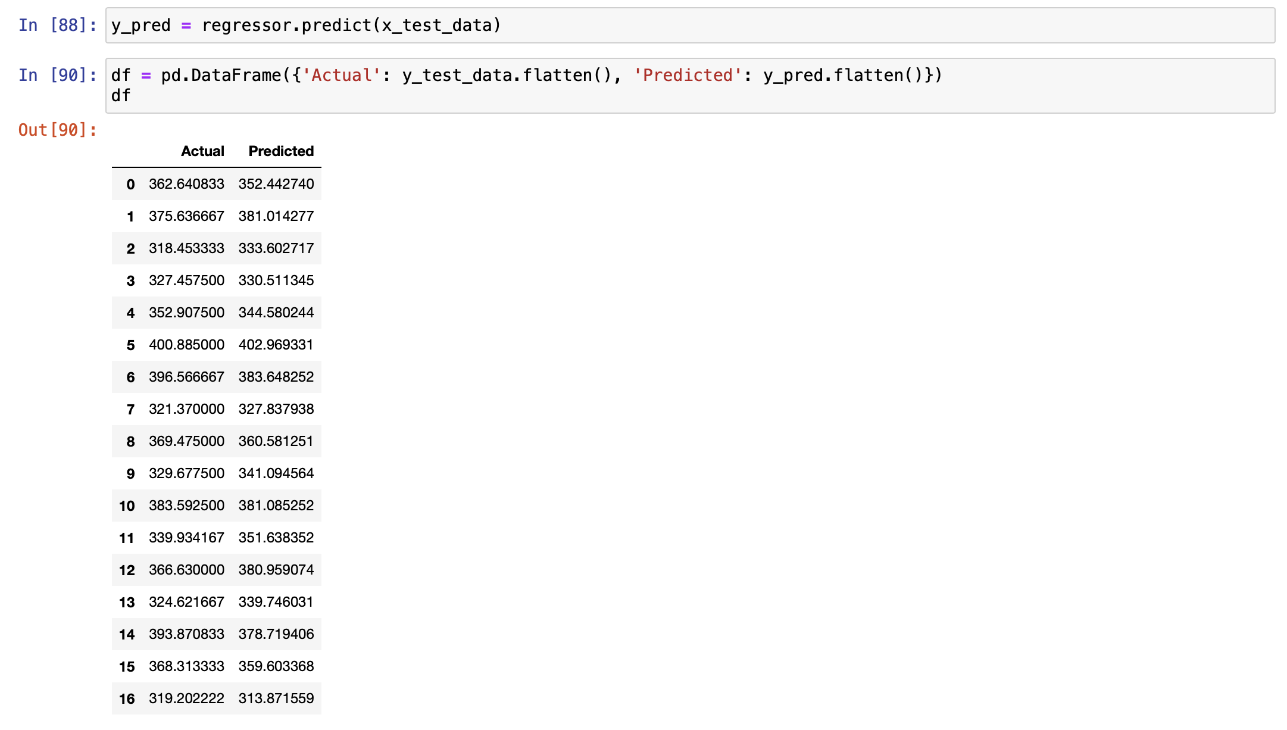
Linear Regression- Test and Actual Visualization

Slide 9
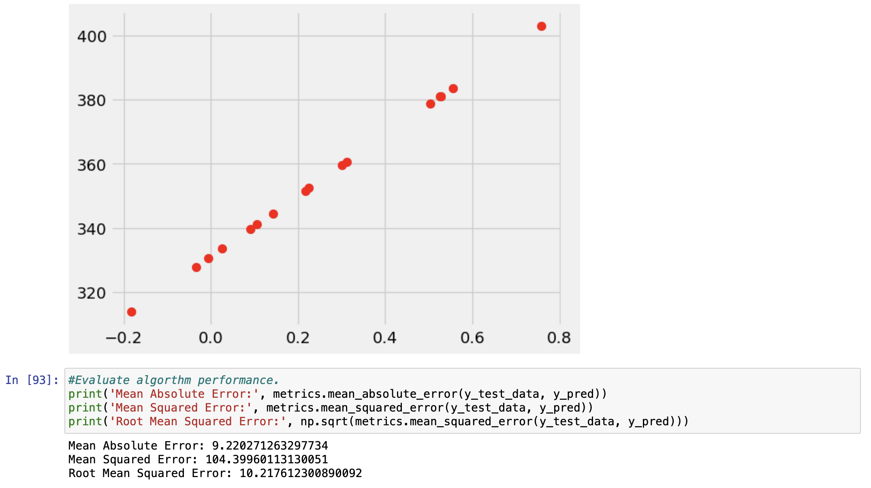
Evaluate Algorithm Performance

Slide 10
10 Research Questions
1) What is your data source and is it reliable?
2) Do we need more data?
3) Are there any inherent biases in your data?
4) Are there any privacy issues?
5) Does the implementation require policy changes?
6) Do we have the right people to implement any changes?
7) Do they require additional training?
8) What is your implementation schedule?
9) What are the cost projections? Do we have funding or require funding?
10) What could go wrong? What have we done well?

